Slide 1
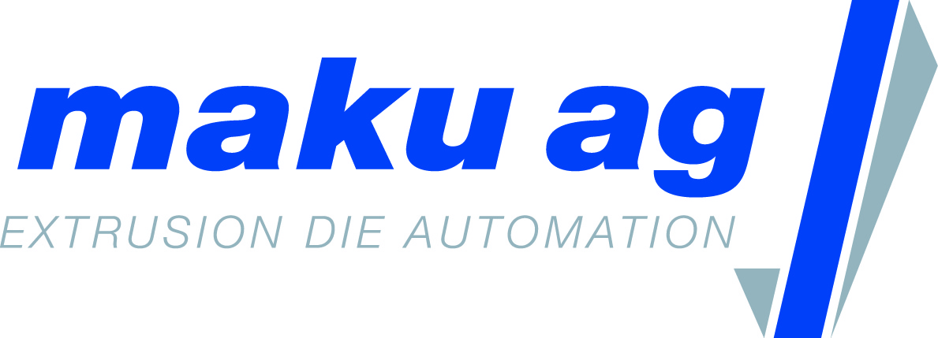
maku-DieTool ®
automatic die lip and restrictor bar adjustment system (patented)

Slide 2
History / Milestones
1983 Foundation of the corporation by Robert Maeder
1985 Development of melt pump controls
1986 Representation of AMUT for Switzerland
1986 Development of maku-Xwind, multi-web large roll winding system
2009 Start of developing the maku-DieTool®
2010 Presentation of the prototype at the K 2010
2011 First order from TESA SE for a laboratory system in Hamburg Germany
2011 Delivery of the first production system to Renolit SE in Worms, Germany
2013 Presentation of a production system with lip adjustment K 2013
2016 Presentation of a production system with lip and restrictor bar adjustment K 2016
2016 European Patent 2657000 issued
2017 United States Patent US 9,649,804 B2 issued
2019 Presentation of a production system with lip and dust bar adjustment K 2019 (compact design)
2020 sold up to 75 units

Slide 3
maku-DieTool®
The in-house developed maku-DieTool® stands for the autonomous adjustment of the die lip and/or the restrictor bar on extrusion dies. The patented die lip and restrictor bar adjustment system is suitable for film and sheet extrusion and can be used on any extrusion die up to a width of 10 meters. The solution can be used with or without any additional gauging system.
The maku-DieTool® can be installed on manual dies or those already equipped with thermal expansion bolts for the production of plastic films and sheets. The following design properties of the die need to be taken into account:
different installation angle of die lip and restrictor bar
die bolt heads with internal or external hex
die bolt types, push or pull/push die bolts
Installation angle of die, vertical or horizontal

Slide 4
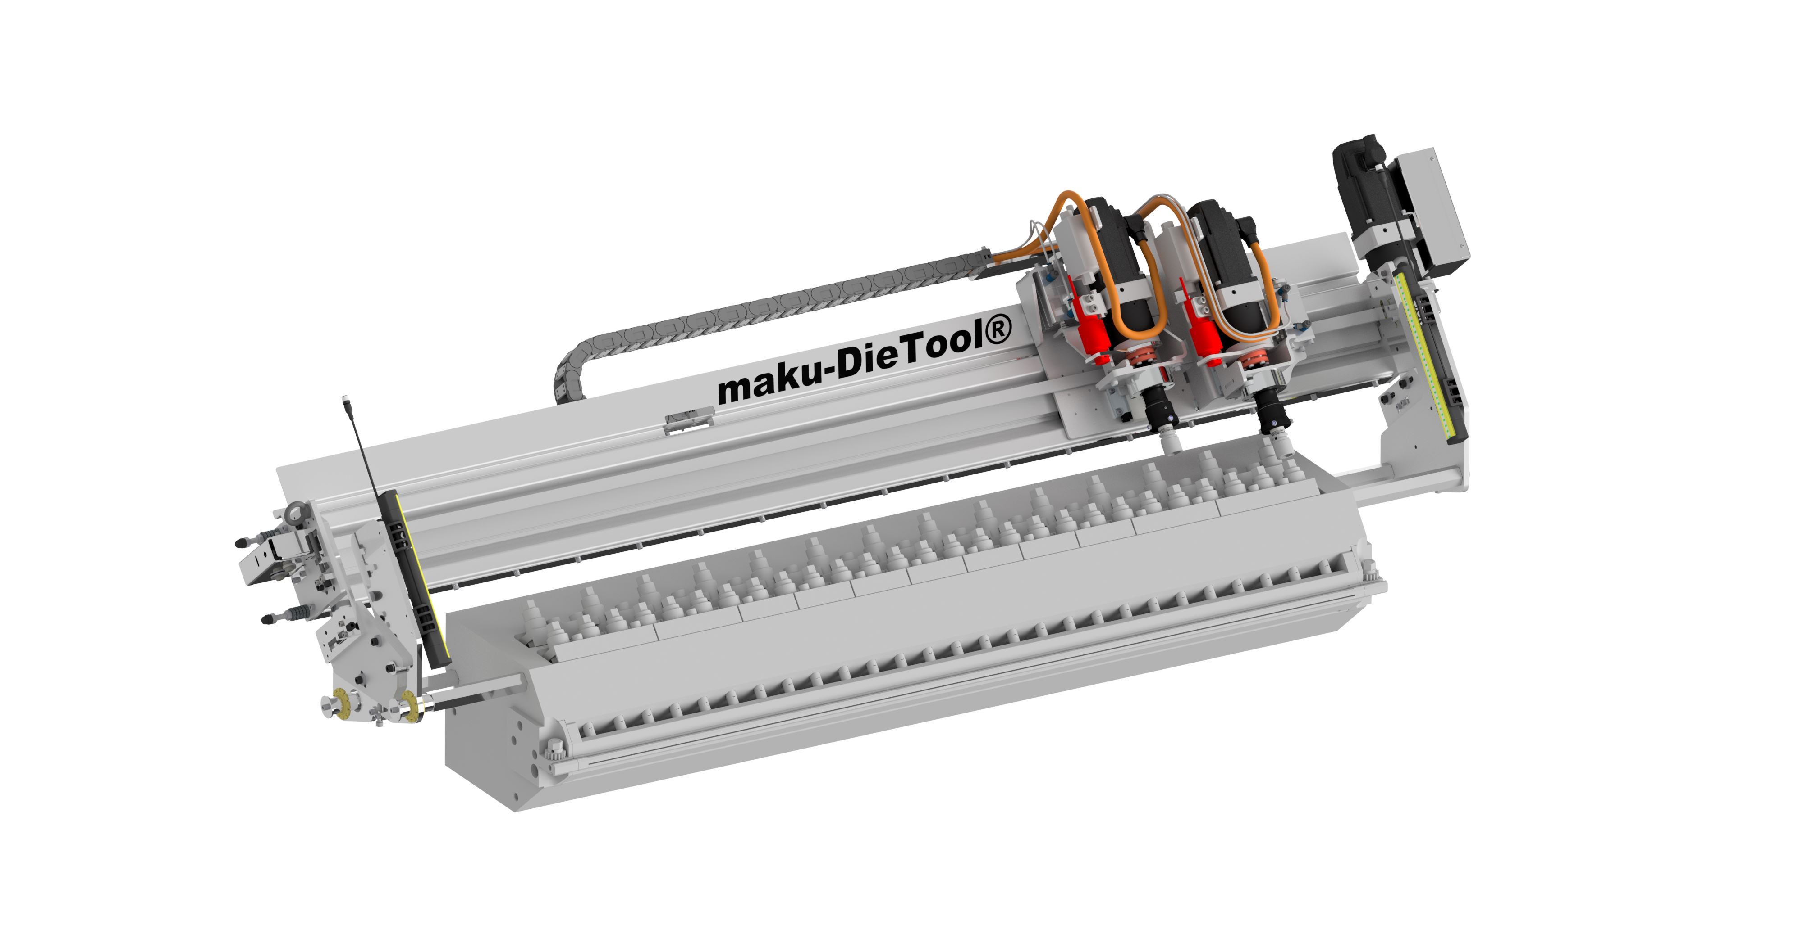
Machinery componence
Cross beam with linear rail
Side brackets with height and cross adjustment
Servo motor for moving the carriage (sideways) by a belt drive
Carriage equipped with servo motor, gearbox and actuator
Pneumatic piston for lowering and raising the actuator
Cable guide
Safety light curtain (optional)

Slide 5
Electrical componence
Control cabinet dimensions in cm: depth 40 x width 60 x height 190 (RAL 9002, including the base) with main power switch and control buttons (control on, start, stop, failure, key switch and emergency stop)
Siemens S7 1500 SPS with Symatic HMITP 1200 comfort touch panel
2 pcs 20 m cables for servomotors, power and encoder
1 pc 20 m cable for positioning sensor, 4 wire cable
1 pc 20 m cable for valve block and pressure sensor, 12 wire cable
1 pc 20 m cable for interlock (if needed)
Cables are disconnectable after cable guide

Slide 6
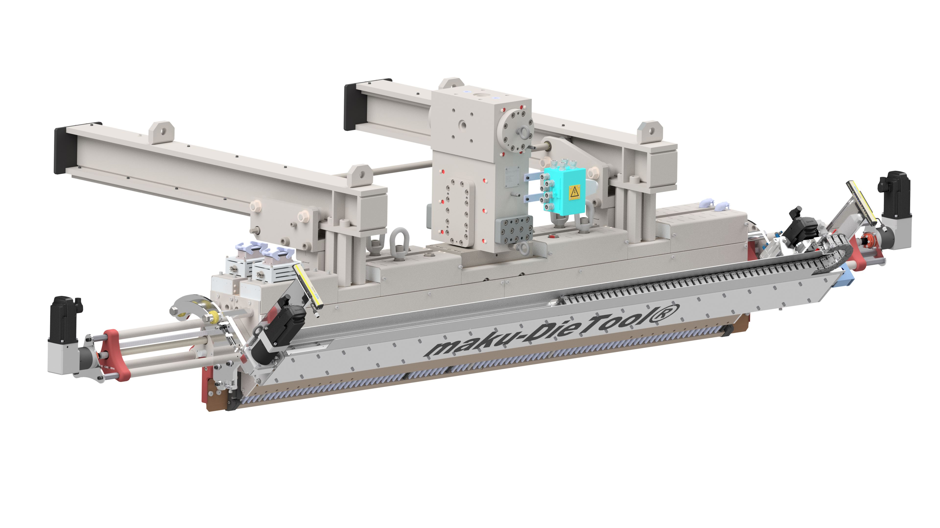
Applications
The maku-DieTool® is used for the following applications:
Cast film, thickness 0.005 – 0.052 mm, extrusion width 500 – 2‘000 mm
Sheet with roll stack, thickness 0.300 – 2.000 mm, extrusion width 800 – 8‘000
Foam sheet, thickness 2.000 -12.000 mm, extrusion width 3‘000 mm

Slide 7
Functionality
The functionality of the maku-DieTool® can be described as follows:
Through manual entries or data protocols from a gauging system, an order of die bolt adjustments with corresponding adjustment values is being established
The linear carriage leaves the parking/home position and travels to the first die bolt position (max. 1 m /sec)
For the first adjustment of a die bolt, the actuator seeks, engages and references the die bolt head by storing the position of the in- or outside hex as well as the depth
According to the adjustment value, the actuator opens or closes the die bolt by taking the die bolt pitch and clearance between the actuator and the die bolt head into account.
The linear carriage goes to the next die bolt according the adjustment algorithm or goes to the park position
Waiting for next adjustment cycle (delay time)

Slide 8
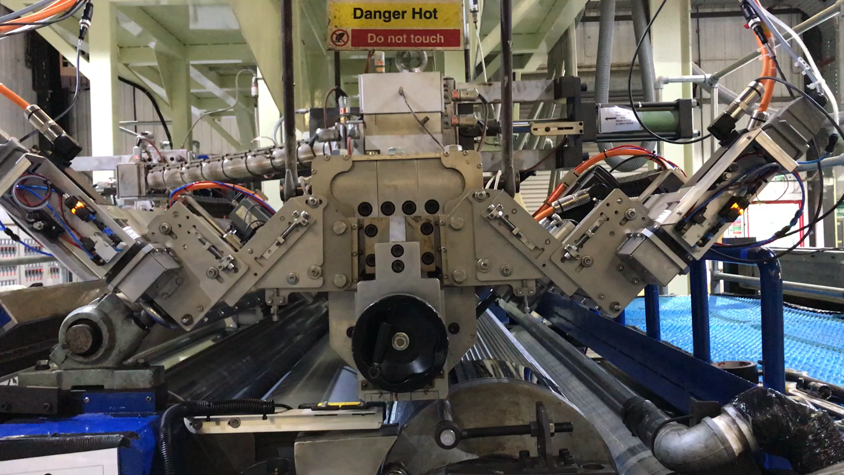
Video of 2 channel die

Slide 9
Properties
Suitable for extrusion dies for the production of films and sheets
Adaptable onto extrusion dies up to a width of 10 m
Adjustment accuracy of +/- 1° angle adjustment
Die lip and restrictor bar adjustment range of 6000 µm
Fully automated internal deckling function
Die lip and restrictor bar profiles can be stored as nominal profiles
Adjusting of push and pull/push die bolts
Low energy consumption
Advantages
No manual intervention necessary on the extrusion die, presettings and fine adjustments are fully carried out by the maku-DieTool®
Low standard deviation due to high adjustment accuracy
Fast changeover times due to real-time adjustment and profile presetting
Cost-effective operation over thermo bolts
Increased safety for the machine operators

